Slide 1
The Email Inbox Overload Problem
ML Engineer Candidate: Aaron Medina
10/30/2022

Slide 2
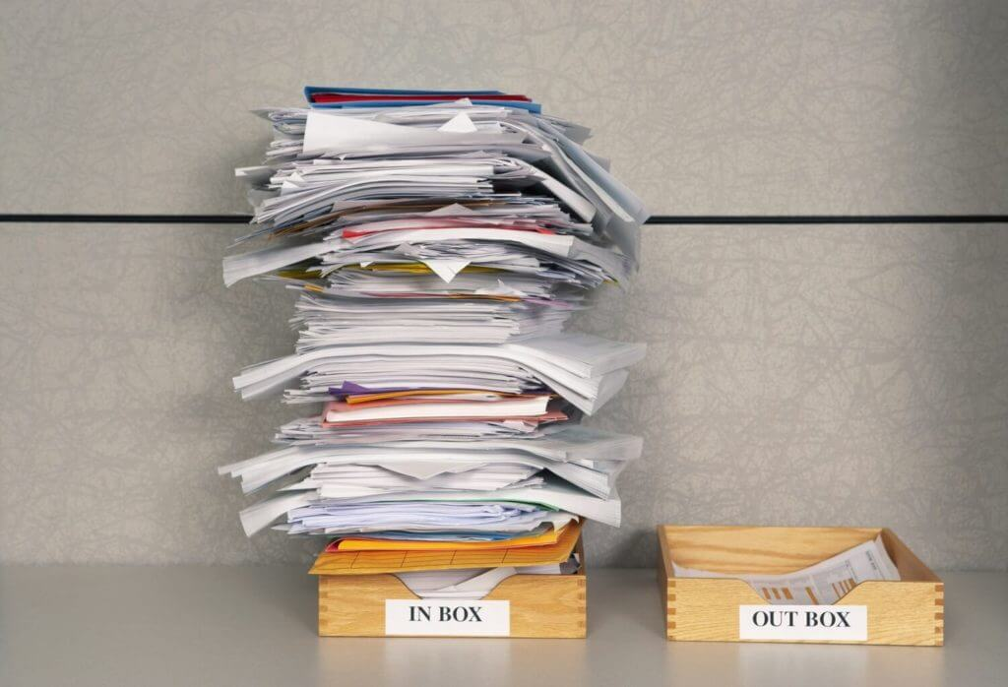
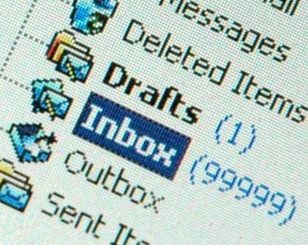
Email Inbox Overload
Having trouble managing your email?
Problems:
- Losing important emails
- No prioritization of tasks
- No organization of topics

Slide 3
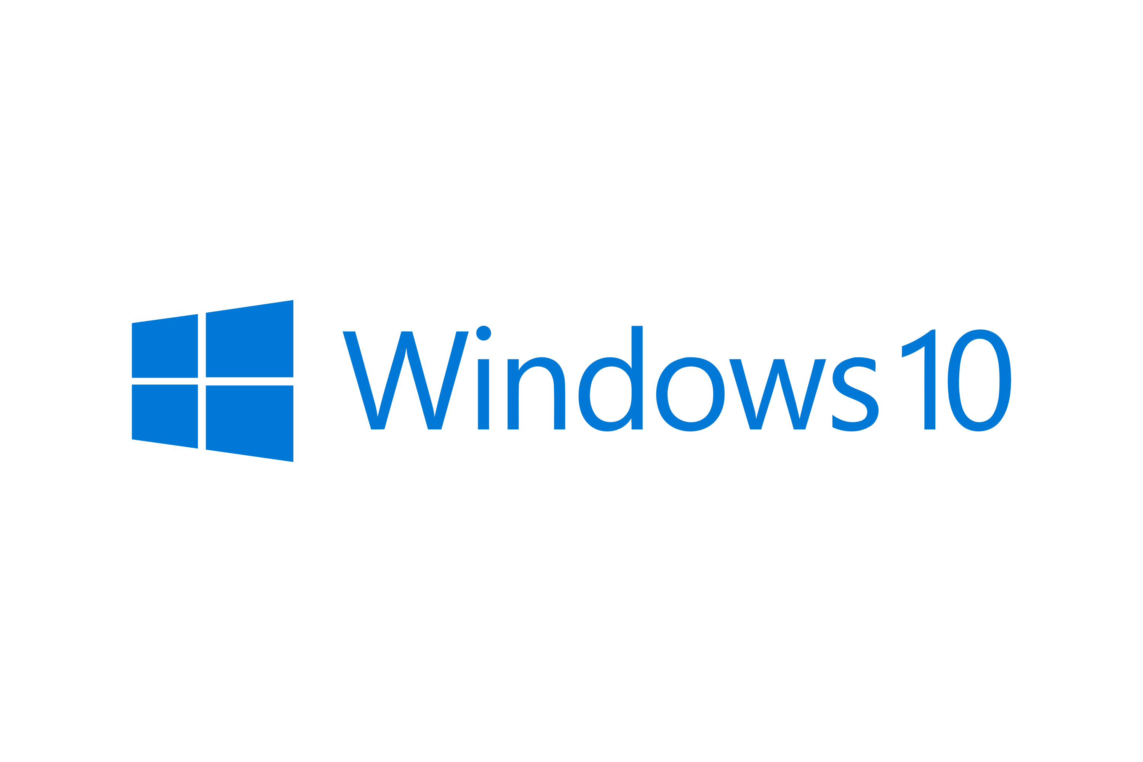



Hardware & Software Config
Good to know my configuration
Windows 10 was my OS (8GB 4 Cpu)
Sklearn ML library
VS Code for script and notebooks
Docker containers

Slide 4
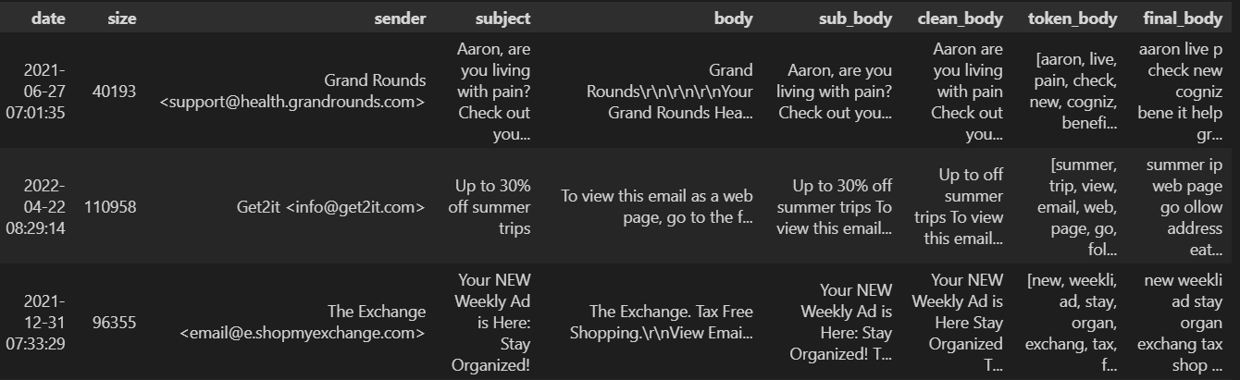
Gmail API Data & Processing
See the NLP cleansing journey
multiple html conversions regex stop words special characters
numbers stemming lemmatizing tokenizing

Slide 5
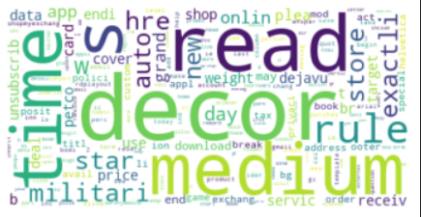
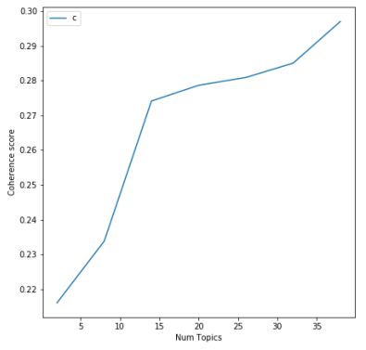
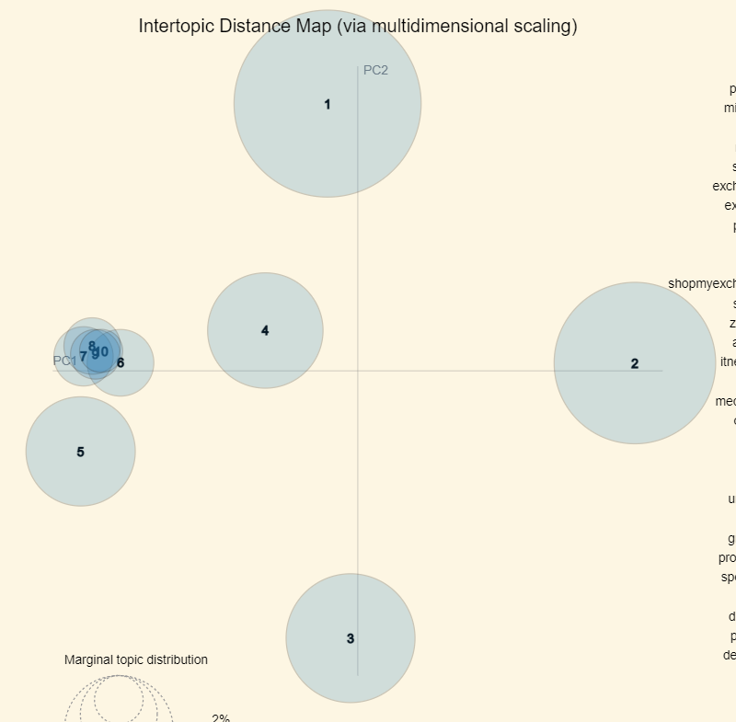
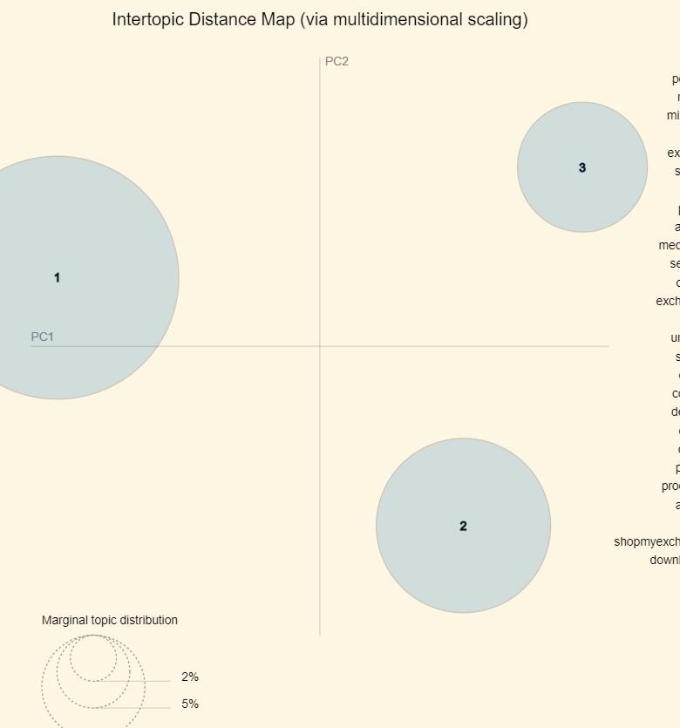
Exploratory Data Analysis (EDA)
Searching for the optimal topics with unsupervised clustering
wordcloud
10 topics
3 topics
LDA Tuning
Coherence Score (could not run)

Slide 6
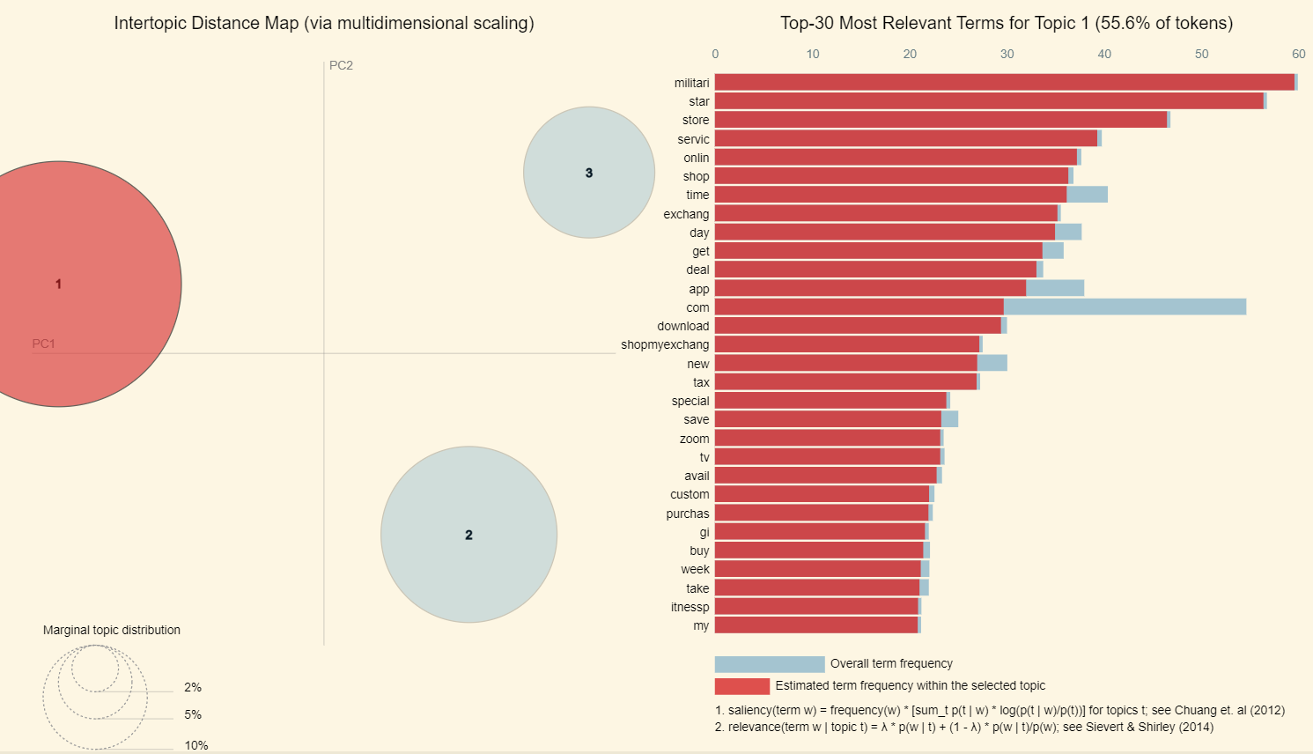
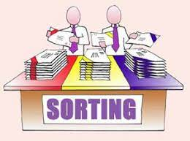
Latent Dirichlet Allocation (LDA)
Reduces dimensionality amongst large bodies of documents
Uncover themes and patterns within your data
Tell the algorithm how many topics you think there are
Assigns every word to a temporary topic
Checks and updates topic assignments

Slide 7
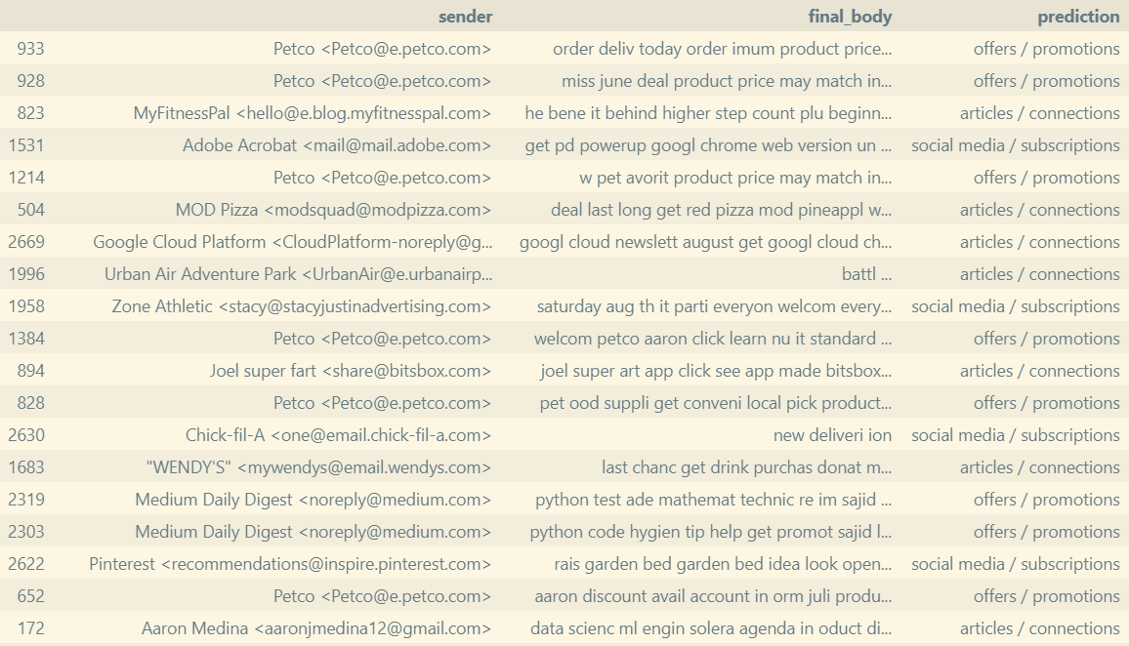



Results
Not perfect, but a good first phase to the solution

Slide 8
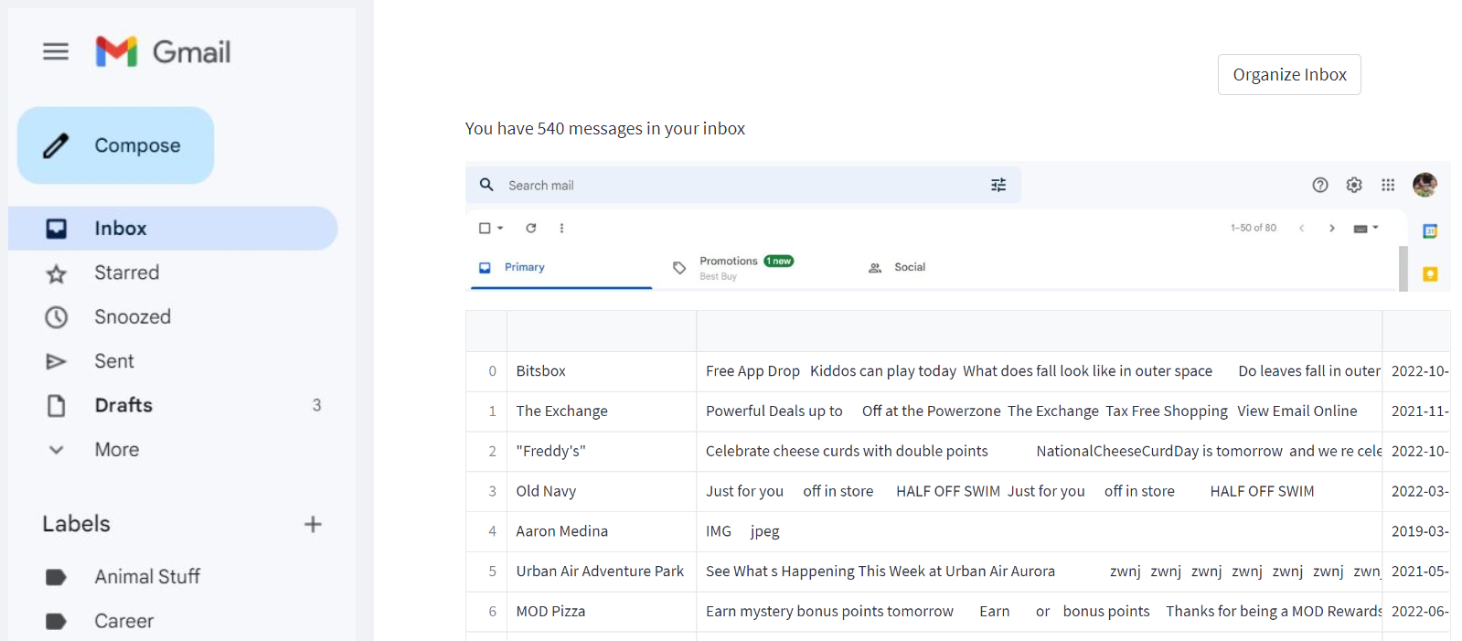
Application Demo
Demonstrating the proof-of-concept (POC)
https://aaronjmedina-email-topic-app-app-3l0pjx.streamlitapp.com/

Slide 9
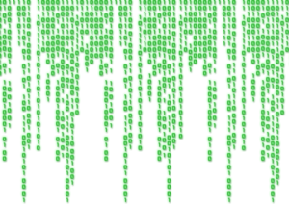

How to improve the model & results
So much room for improvement via tuning and data opps
Still much work is needed to improve the data extraction process
Image recognition & extraction could add more content
Allow more time to determine optimal model coherence k topics
Create a sample ground-of-truth label for further ML evaluation

